Slide 1
12.06.2024
Final Presentation
Principle of Autonomy and Decision Making
Chirag Tank cht8982

Slide 2
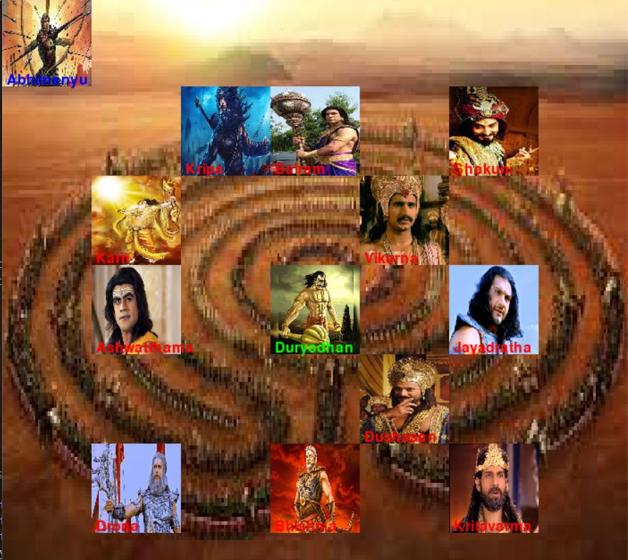
Environment Concept : Mahabharat’s Chakravyuha (7,7)
Assignment – 1 Custom Environment
Agent – Abhimanyu (0,0)
Goal – Duryodhan (3,3)
Obstacles
Karn (2,1)
Balram (1,3)
Shakuni (1,5)
Ashwatthama (3,1)
Drona (5,1)
Bhishma (5,3)
Kritavarma (5,5)
Jayadratha (3,5)
Kripa (1,2)
Dushasan (4,4)
Vikarna (2,4)

Slide 3
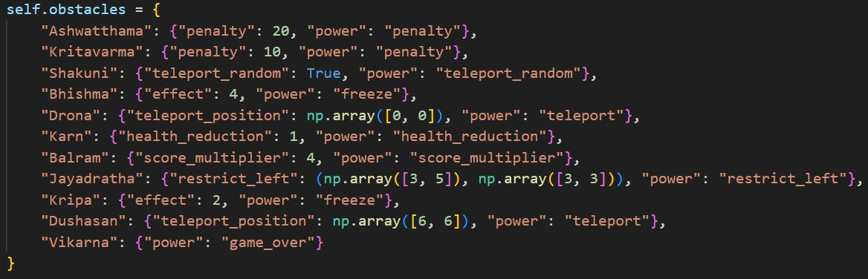
Components of Environment
Assignment-1 Custom Environment
Obstacle powers
Penalty
Ashwatthama – 20 reward
Kritavarma – 10 reward
Teleport
Shakuni - Teleport (Random)
Drona - Teleport (0,0)
Dushasan - Teleport (6,6)
Freeze action
Bhishma - Next 4 steps
Kripa - Next 2 steps
Restrict Left action
Jayadratha - (3,5) to goal (3,3)
Health score
Karn - 3 → 0 += Penalty
Score multipier
Balaram - Reward : X → 4X
Game over
Vikarna - ☹ ☹ ☹

Slide 4
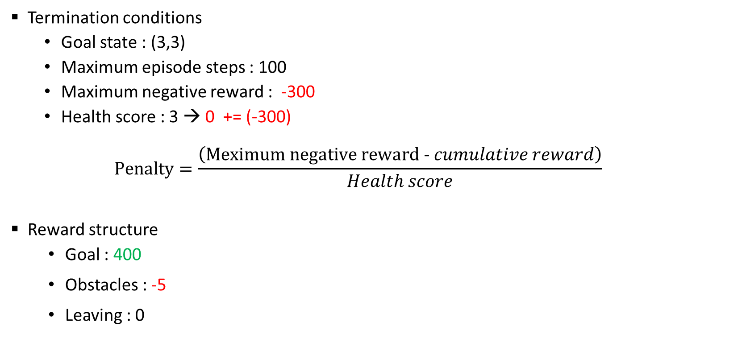
Components of Environment
Assignment-1 Custom Environment
Termination conditions
Goal state : (3,3)
Maximum episode steps : 100
Maximum negative reward : -300
Health score : 3 → 0 += (-300)
$$Penalty=\frac{\left(\text{Meximum} \text{negative} \text{reward}\text{ - }cumulative reward\right)}{Health score}$$
Reward structure
Goal : 400
Obstacles : -5
Leaving : 0

Slide 5
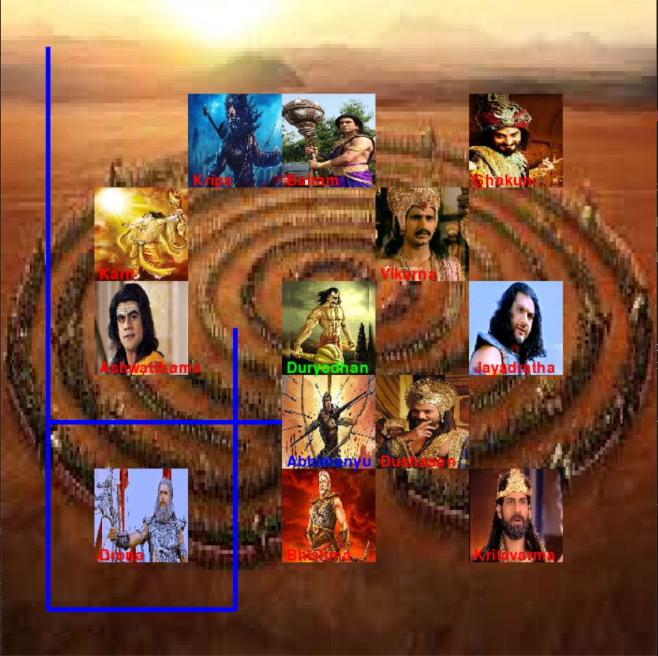
Visualization : If agent behaves as a Human
Assignment-1 Custom Environment

Slide 6
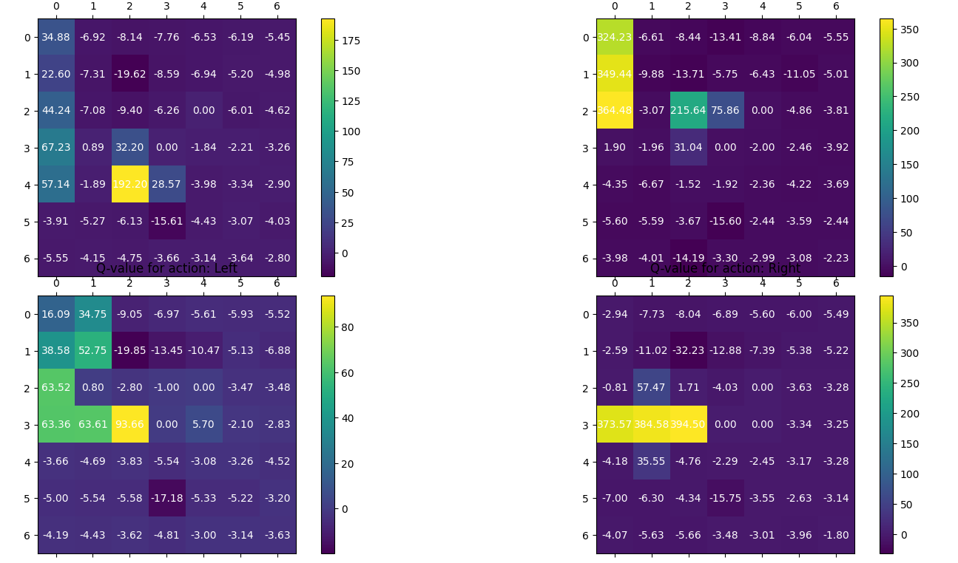
Trials and Error
Assignment-3 Training Agent using Q-Learning
Trial – 1
Agent passed through obstacles
no_of_ep = 1000
Reward = -5
Learning rate – 0.01
Cumulative reward - 395

Slide 7
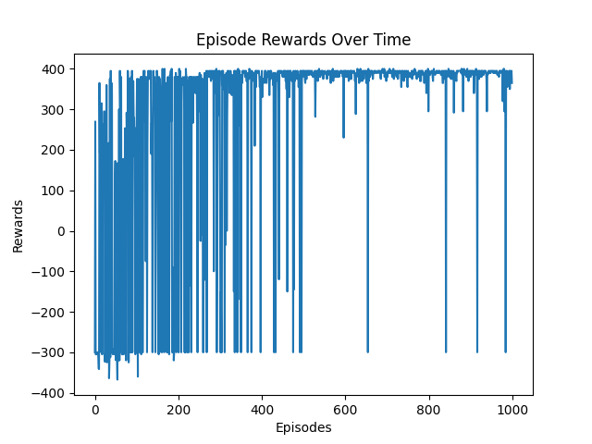
Trials and Error
Assignment-3 Training Agent using Q-Learning
Trial – 1
Agent passed through obstacles
no_of_ep = 1000
Reward = -5
Learning rate – 0.01
Cumulative reward - 395

Slide 8
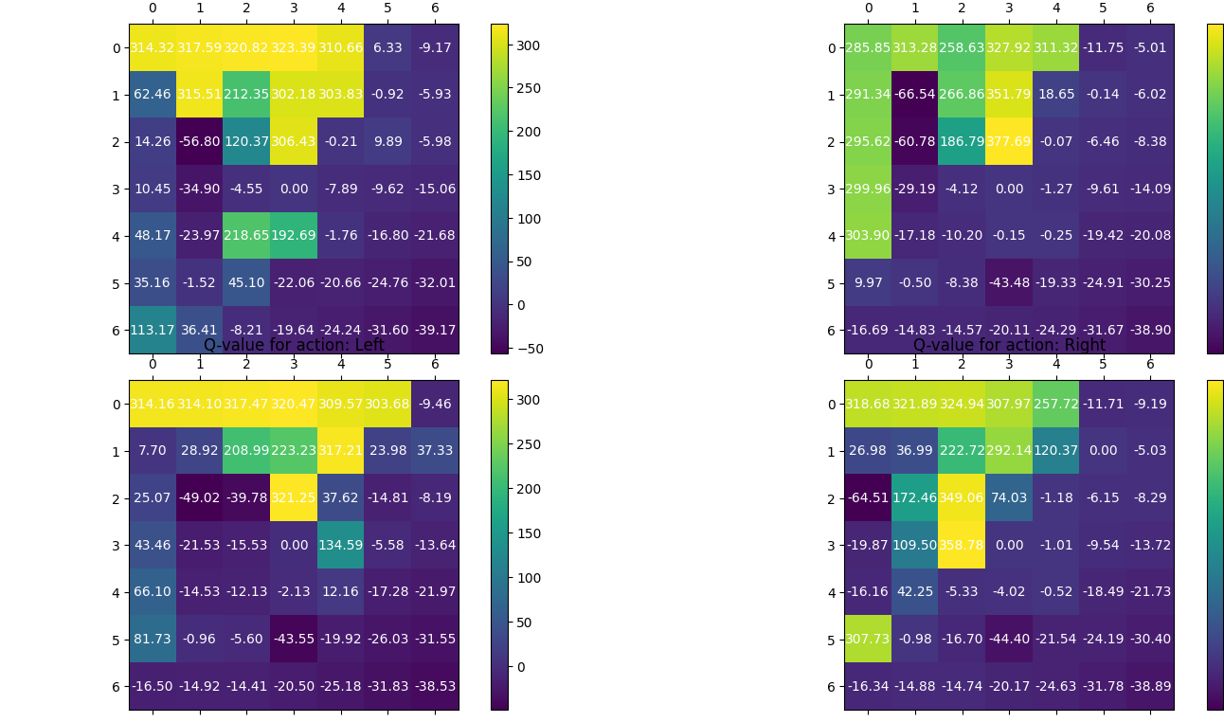
Trials and Error
Assignment-3 Training Agent using Q-Learning
Trial – 2
Agent passed through obstacles
no_of_ep = 50000
Reward = -5
Cumulative reward - 380

Slide 9
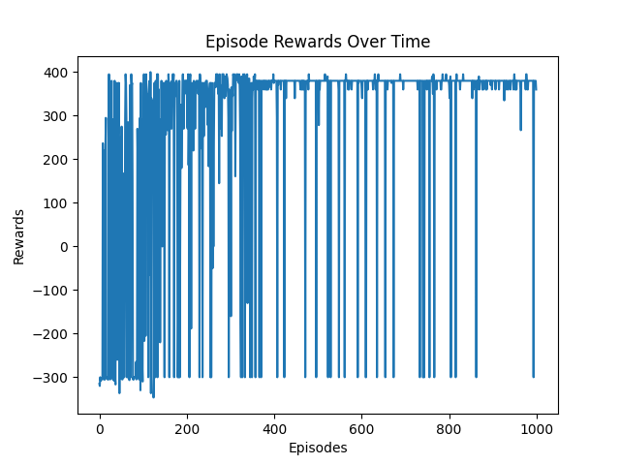
Result validation
Assignment-3 Training Agent using Q-Learning
no_episodes = 50000 |  |  |  | individual obstacle reward- -5
step no. | state | up | down | left | right | reward
0 | 0,0 | 314 | 285 | 314 | 318 | 0
1 | 0,1 | 317 | 313 | 314 | 321 | 0
2 | 0,2 | 320 | 258 | 317 | 324 | 0
3 | 0,3 | 323 | 327 | 320 | 307 | 0
4 | 1,3 | 302 | 351 | 223 | 292 | -20
5 | 2,3 | 306 | 377 | 321 | 74 | 400
 | 3,3 | 0 | 0 | 0 | 0 | 380
Trial – 2
Agent passed through obstacles
no_of_ep = 50000
Reward = -5
Cumulative reward - 380

Slide 10
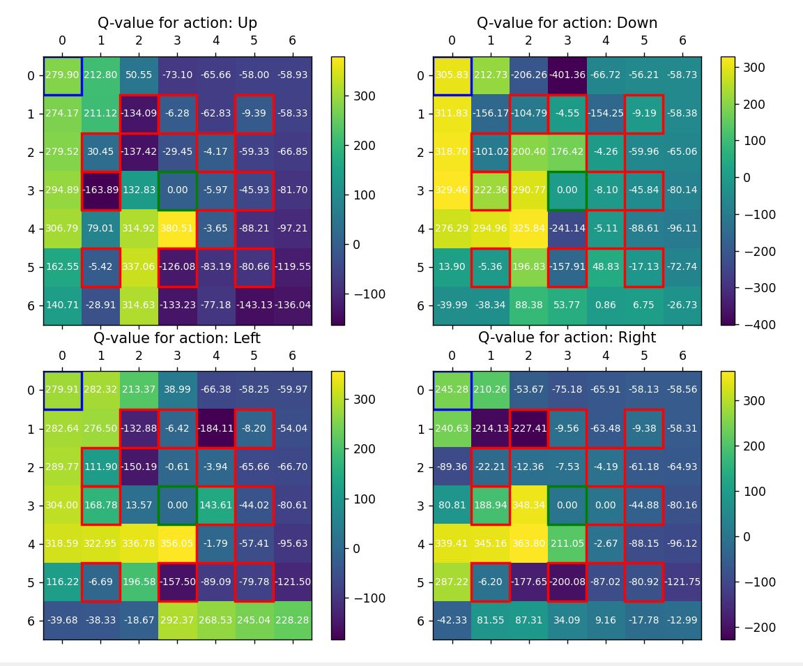
Trials and Error
Assignment-3 Training Agent using Q-Learning
Trial – 3
Agent reach to goal
no_of_ep = 100000
Reward = -100
Cumulative reward - 400

Slide 11
Trials and Error
Assignment-3 Training Agent using Q-Learning
Trial – 3
Agent reach to goal
no_of_ep = 100000
Reward = -100
Cumulative reward - 400

Slide 12
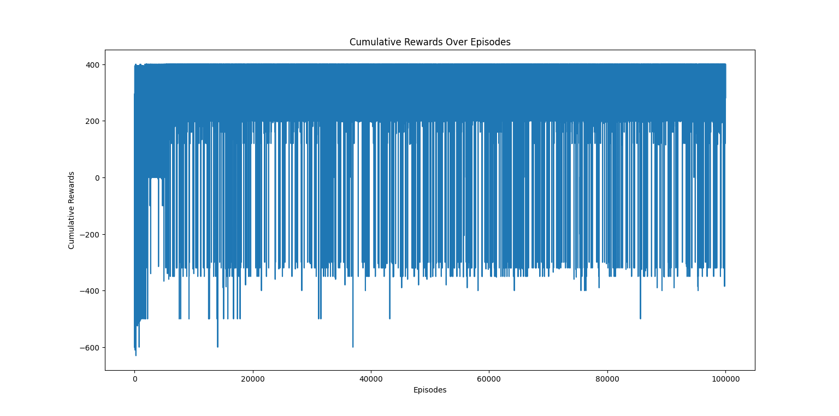
Result validation
Assignment-3 Training Agent using Q-Learning
Agent reach to goal
no_of_ep = 100000
Reward = -100
Cumulative reward - 400

Slide 13
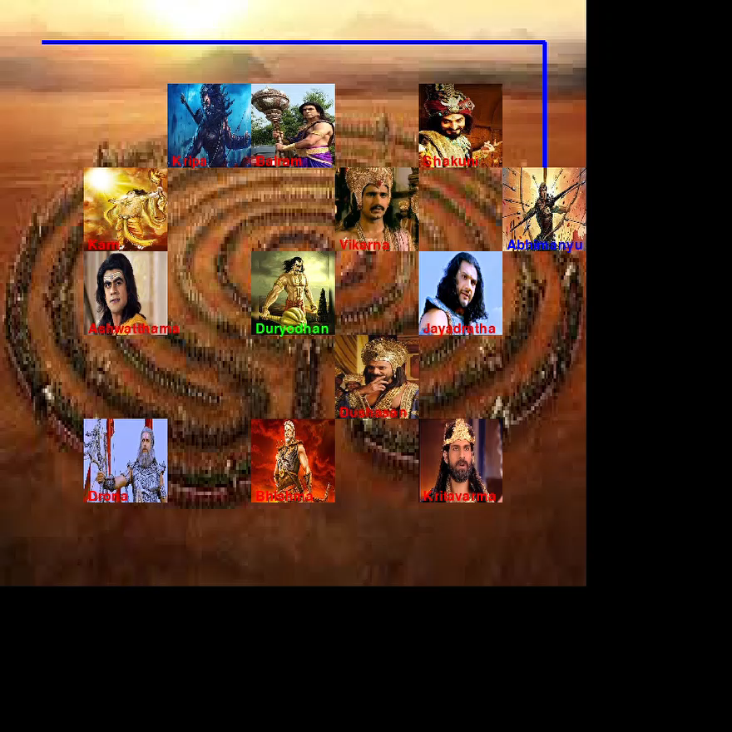
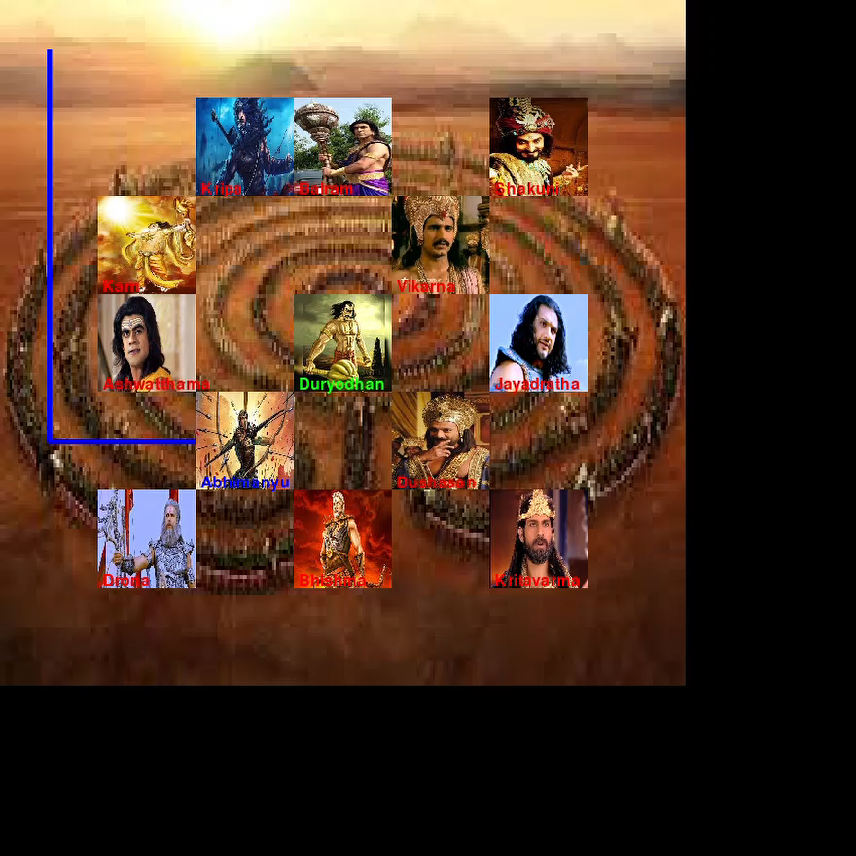
Agent during training
Assignment-3 Training Agent using Q-Learning
Agent Trained
Optimal Policy Visulisation

Slide 14
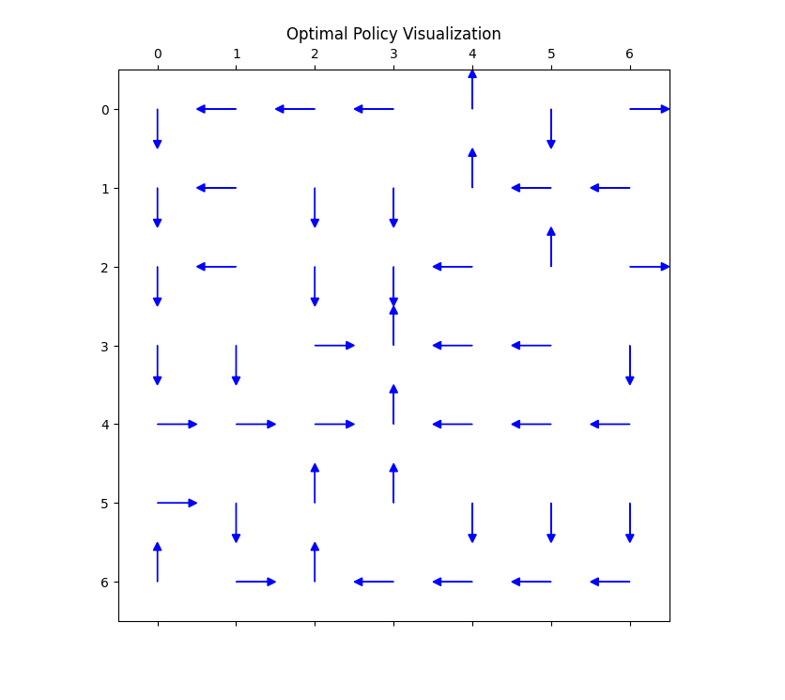
statistics and analyses
Assignment-3 Training Agent using Q-Learning
Optimal Policy Visulisation

Slide 15
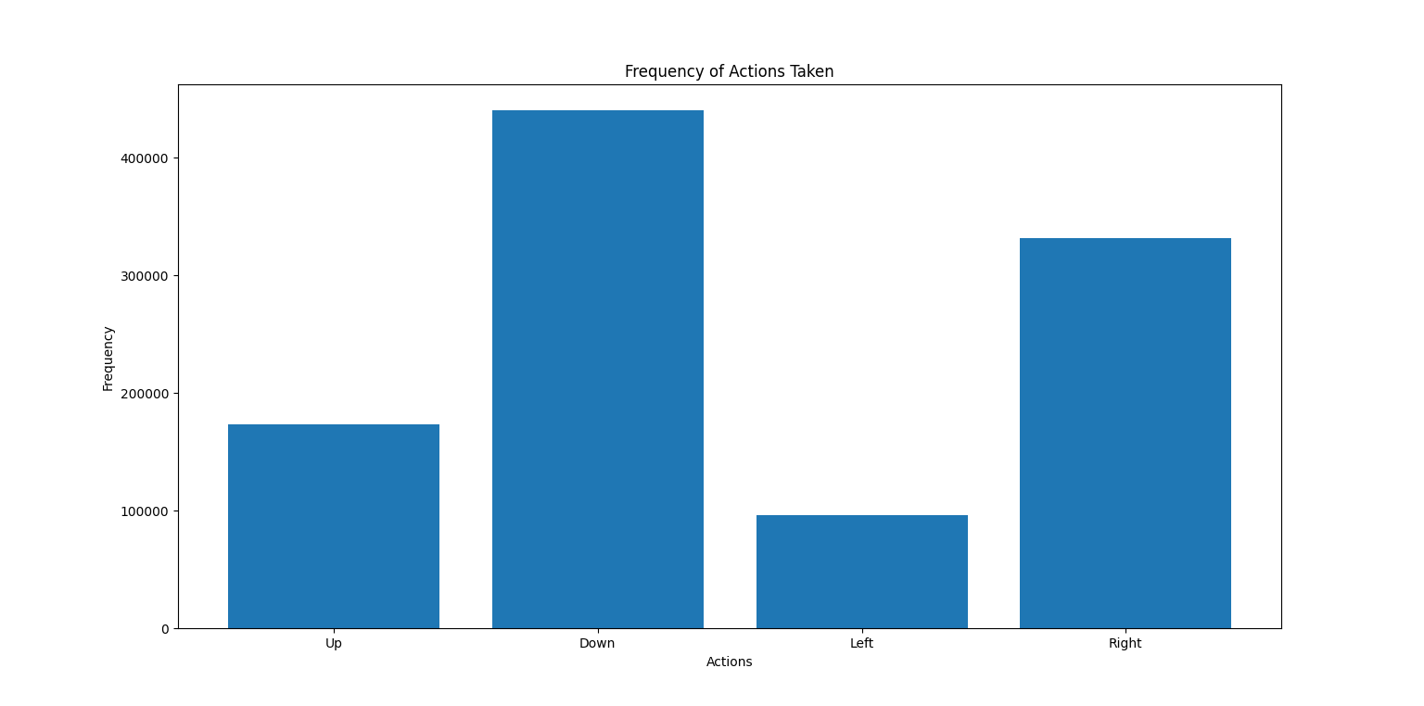
statistics and analyses
Assignment-3 Training Agent using Q-Learning
Frequency of Action Taken

Slide 16
Learning and future work
PADM
Building a custom environment
Training agent
Modifications in environment due to dynamic nature
Changed characters power
Shakuni (reverse action)
DQN based dynamic environment training

Slide 17
12.06.2024
Thank you for opportunity to present myself !!
Chirag Tank (cht8982)
It's been great learning experience for me !!

